Slide 1

Subject Code: SCS1301 Subject Name: Operating System Faculty Name: Dr. A. Jesudoss

Slide 2
Roadmap to UNIT I
Introduction
Operating system structures
System Components
OS Services
System Calls
System Structure
Resources
Processes
Threads
Objects
Device Management
Different approaches
Buffering device drivers.

Slide 3
CLASSIFICATION OF OPERATING SYSTEMS
Multi-User OS
Allows two or more users to run programs at the same
This type of operating system may be used for jsut a few people or hundreds of them.
In fact, there are some operating systems that permit hundreds or even thousands of concurrent users.

Slide 4
2) Multiprocessing OS
Support a program to run on more than one central processing unit (cpu) at a time.
This can come in very handy in some work environments, at a schools and even for some home-computing situtations.

Slide 5
3) Multitasking OS
Allows to run more than one program at a time.
4) Multithreading OS
Allows different parts of a single program to run concurrently (simultaneously or at the same time).
Real Time OS
These are designed to allow computers to process and respond to input instantly.
Usually, general purpose operating systems, such as disk operating system (DOS), are not considered real time, as they may require seconds or minutes to respond to input.

Slide 6
Real-time operating systems are typically used when computers must react to the consistent input of information without delay.
For example, realtime operating systems may be used in navigation. General-purpose operating systems such a

Slide 7
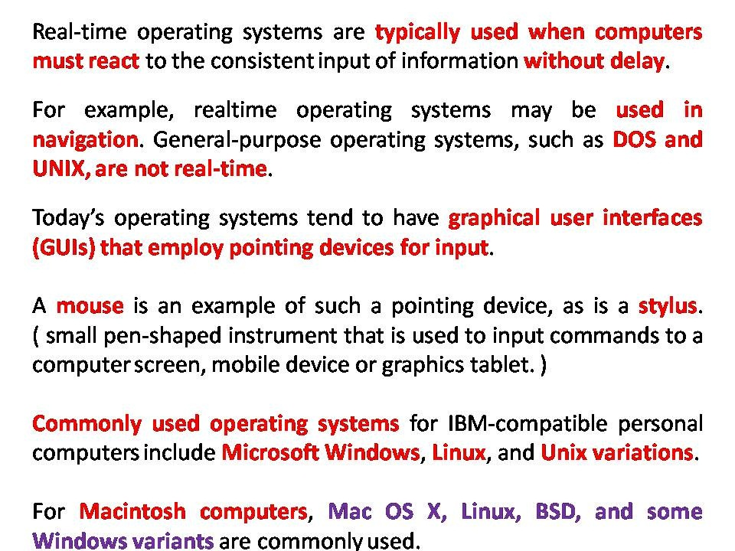

Slide 8
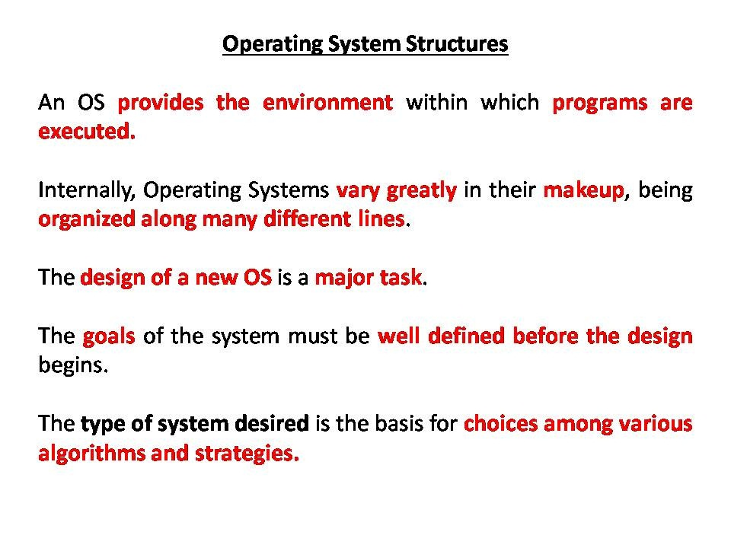

Slide 9
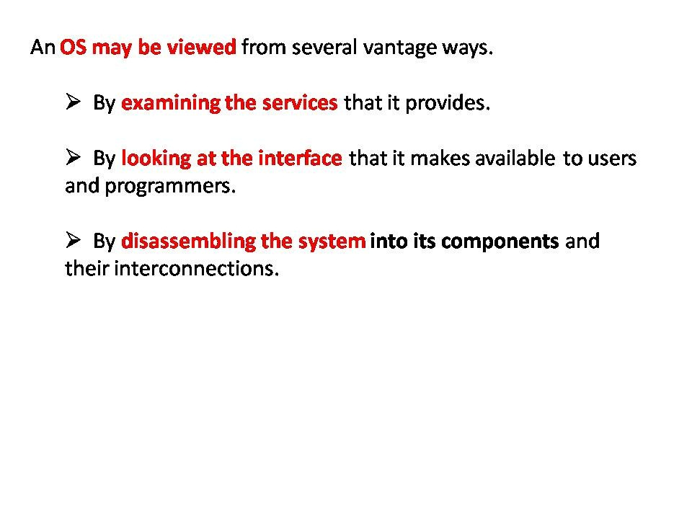

Slide 10
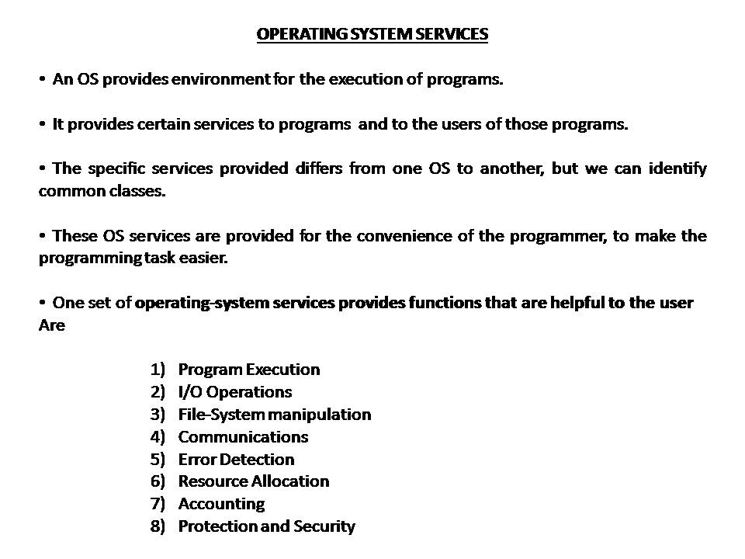

Slide 11
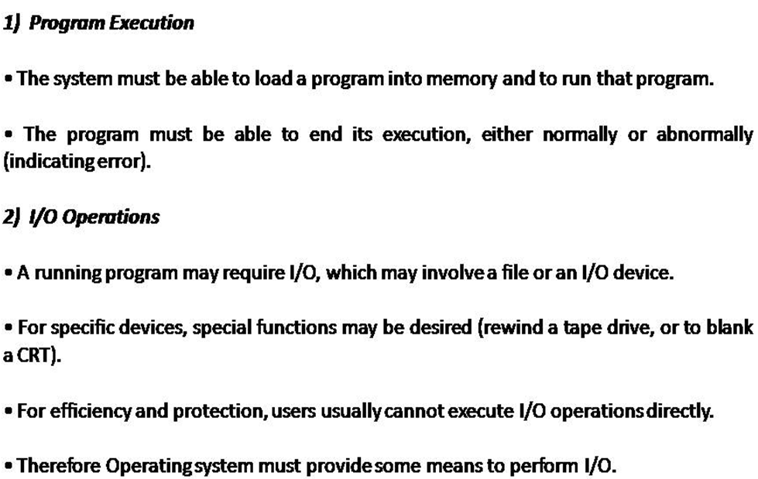

Slide 12
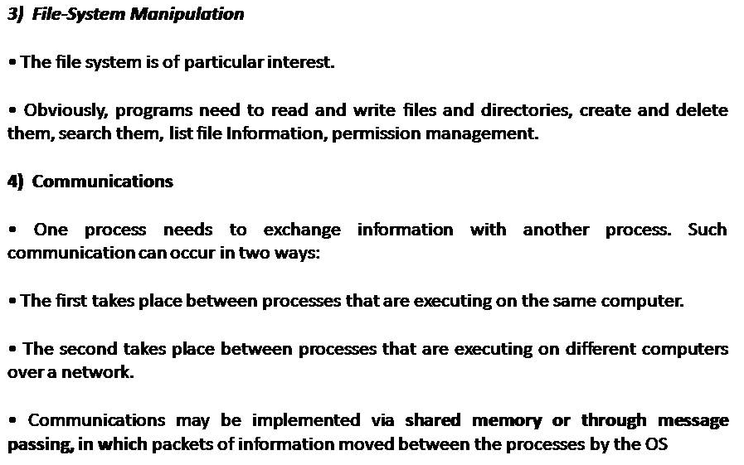

Slide 13
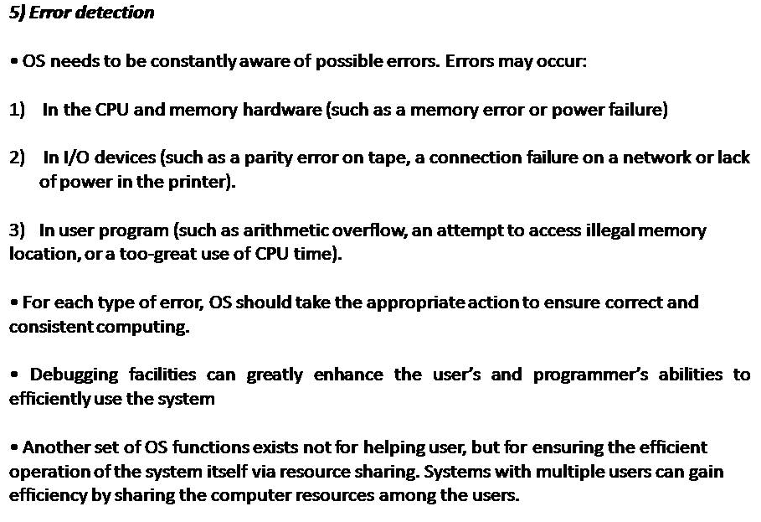

Slide 14
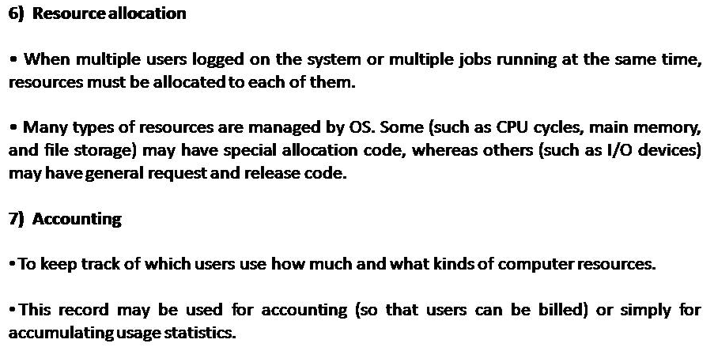

Slide 15
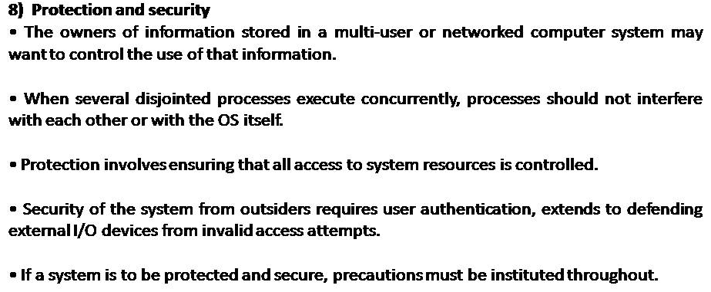

Slide 16
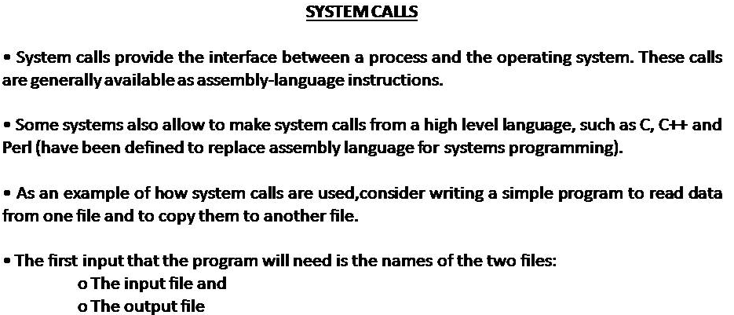

Slide 17
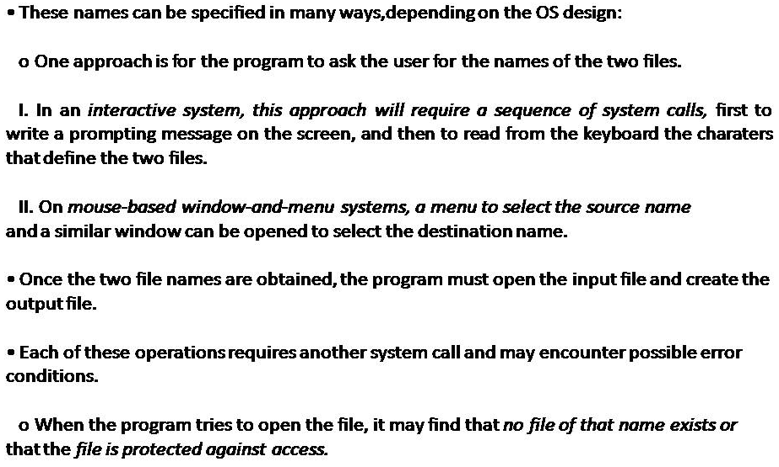

Slide 18
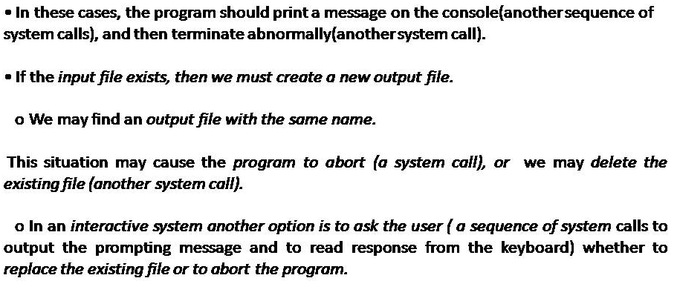

Slide 19
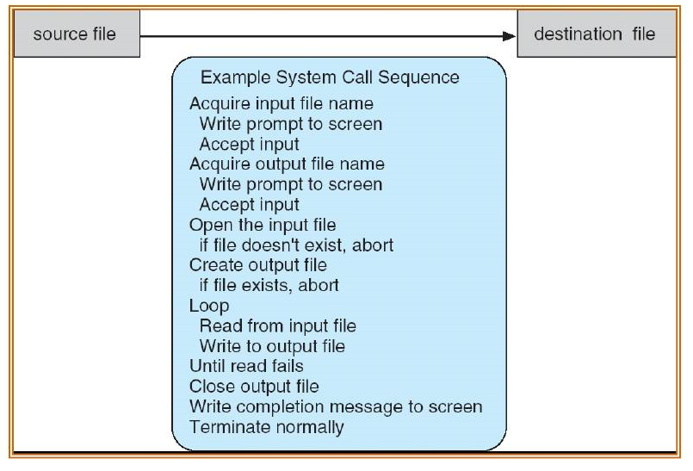

Slide 20
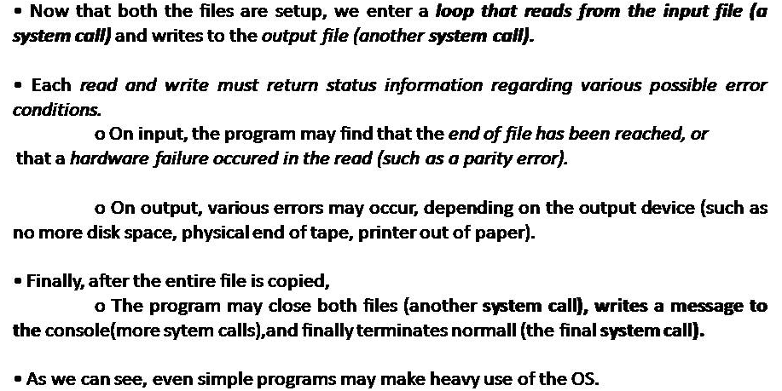

Slide 21
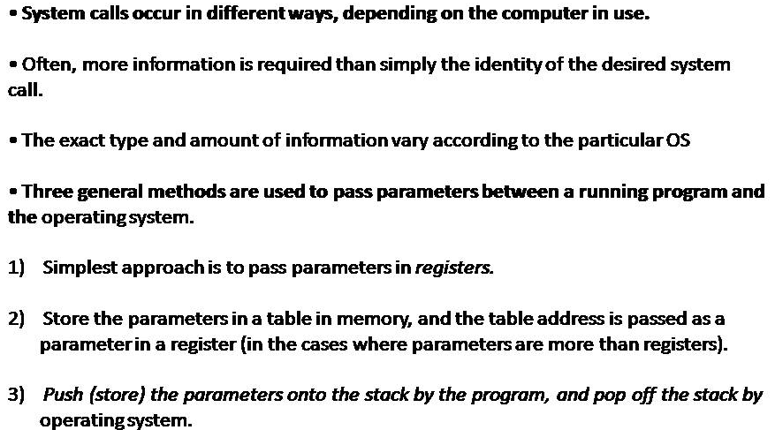

Slide 22
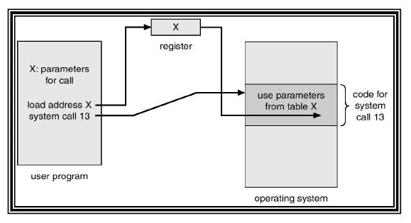

Slide 23
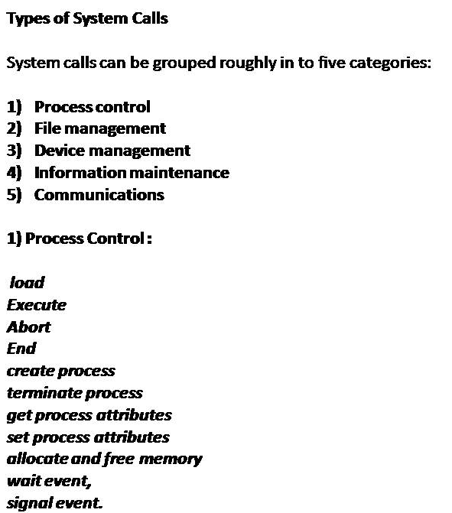

Slide 24
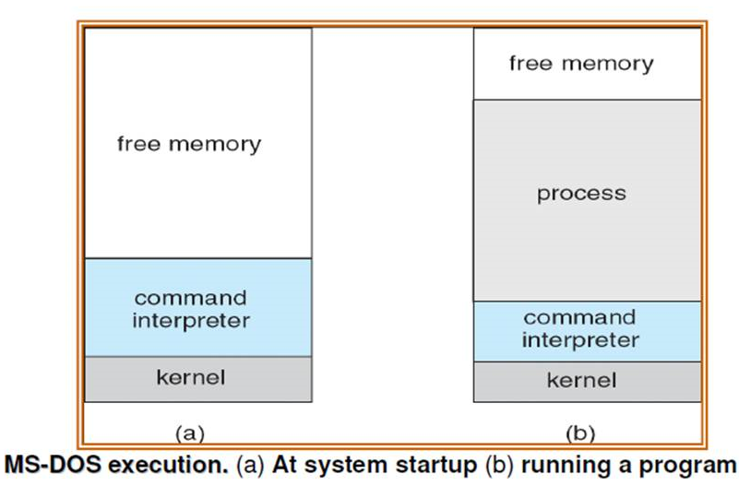

Slide 25
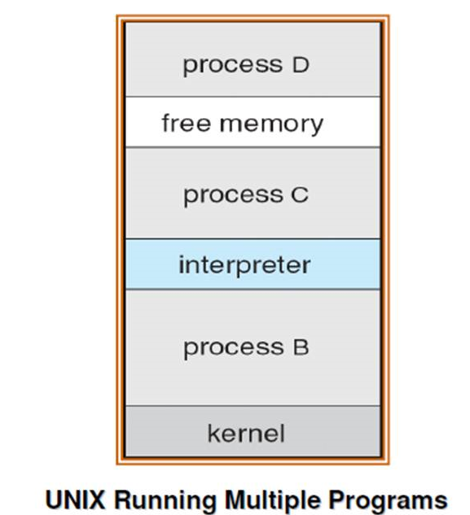

Slide 26
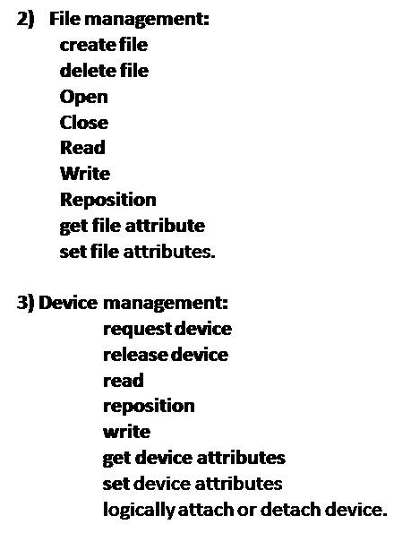

Slide 27
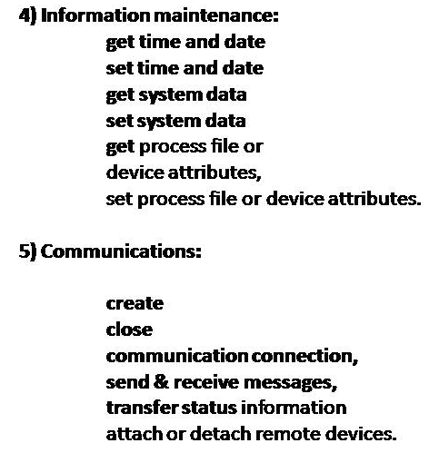

Slide 28
